Slide 1
Situating the “new dementia” – context and diversity in dementia prevention
CCNA, April 2021
Annette Leibing, PhD
Professor, medical anthropology
Université de Montréal
Centre de recherche et d’expertise en gérontologie sociale (CREGÉS)

Slide 2
Situating myself (“without crossing over”)
studies of health X
studies for health (thinking within the same paradigm)
“Si elle réussit, les deux parties se découvriront différentes d’elles-mêmes, différentes de ce qu’elles croyaient être.” (Patrice Maniglier, 2017)
Gillian Einstein and Neil Cashman (CCNA talk): feminist theory and physiological body.

Slide 3
Today…
“Old” versus “new” dementia
Situating the “new” dementia
Epidemiological studies
Intervention studies
Knowledge translation
Case study: situating prevention in Brazil
(future: Germany, Canada, Switzerland)
Conclusion

Slide 4
“Old” versus “new” dementia

Slide 5
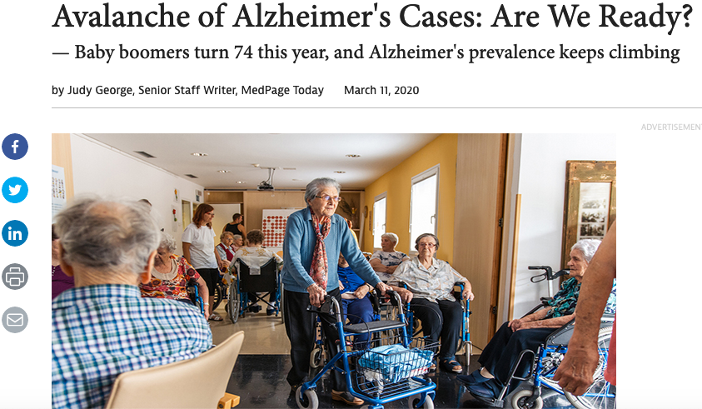
The brain: Use it or lose it!
Alz.org
German Berrios (1987, 1989): 'Cognitive paradigm’ – “the view that an impairment of cognition (in practical terms,
a memory deficit) is sufficient to define dementia.”

Slide 6
“… dementia just consisted of an irreversible disorder of intellectual functions. Historical analysis shows that this view resulted more from ideology than clinical observation. For decades, the cognitive paradigm has prevented the adequate mapping of the non-cognitive symptoms of dementia and hindered research.”
German Berrios (1996: 172)

Slide 7
The “new dementia”: opening up the “cognitive paradigm”
‘Old’ dementia | ‘New’ dementia
Focus on cognitive impairment* | BPSD* (Behavioral and Psychological Symptoms of dementia) *See Leibing, A. – From the Periphery to the Center, Treating Noncognitive, Especially Behavioral and Psychological, Symptoms of Dementia. In: Do we Have a Pill for That? Treating Dementia. J. Ballenger, et al. (eds.). The Johns Hopkins U. Press, 2009.
 | Early detection + early intervention**, biomarkers, MCI (mild cognitive impairment) ** see Leibing, A. - The earlier the better – Alzheimer’s prevention, early detection, and the quest for pharmacological interventions. Culture, Medicine & Psychiatry 38(2) : 217-236, 2014 .
Prevention = brain training (‘use it or lose it’) | Prevention: Brain is body – esp. cardiovascular risk factors (see Lancet and others); The merging of vascular dementia and Alzheimer’s disease *** see Leibing, A. - The vascularization of Alzheimer’s disease – Making sense of prevention. In: Leibing, A. and S. Schicktanz (eds.), Preventing Dementia? Critical perspectives on a new paradigm of preparing for old age. New York/Oxford: Berghahn, 2020.
Genetic explanation (1990s - ) | “brain is body” (risk factors, microbiome…), genetics weaker explanation
See Berrios (1987, 1989): 'Cognitive paradigm’ – “the view that an impairment of cognition (in practical terms, a memory deficit) is sufficient to define dementia.”
* The development of the Consensus Statement on Behavioral and Psychological Symptoms of Dementia (BPSD) represents a first step towards recognizing that these are core symptoms of dementia and that it is as essential to study and treat them as it is to study and treat any other aspects of dementing disorders” (Finkel 1996)

Slide 8
Lancet Report (Livingston et al. 2017): 9 factors: Less education, midlife hearing loss, obesity, hypertension, late-life depression, smoking, physical inactivity, diabetes, and social isolation Lancet Report (Livingston et al. 2020): + excessive alcohol consumption, traumatic brain injury, and air pollution Prevention or risk reduction?
Dementia prevention, the “new dementia”
”One Third of Dementia Cases May Be Preventable”
Notes:
Early life - Education
Mid-life - Hypertension; Obesity; Hearing loss
Later life - Depression; Diabetes; Physical inactivity; Smoking; Low social contact

Slide 9
AD as linked to lifestyle (“old new”)
“Sometime in the late 90s or early 2000’s I presented a paper on the relationship between lifestyle factors and dementia risk. (…) At the meeting I was invited to speak at a press conference by the Alzheimer’s Association (…). At the press conference I spoke about our work and my suggestion that the available literature suggested that it was wise for people to avoid smoking, manage their blood pressure and diabetes, avoid obesity, live a life with high levels of physical and mental activity, avoid a high-fat diet and avoid head injuries. When I finished [someone from the Alzheimer's Association] got up and raised his hands out wide to the right and left for emphasis and said “Wait!, Dr. Friedland’s suggestions have not yet been verified by a double-blind placebo-controlled randomized trial!” I explained that what I had recommended was already known to be good for people anyway. There was nothing I proposed that could possibly be harmful! I think the problem is that many people cannot see the forest for the trees in their search for scientific rigor. They forget that “absence of evidence is not evidence of absence”.”
(Robert P. Friedland 2019, interview with AL)

Slide 10
2. Situating the “new” dementia
Why is this important?

Slide 11
Situating the ‘new’ dementia
The “new” dementia = internationally circulating hopeful knowledge
Why the need to situate such knowledge?
Definition:
Chandler and Munday (2011): situatedness is “[t]he dependence of meaning (and/or identity) on the specifics of particular sociohistorical, geographical, and cultural contexts, social and power relations, and philosophical and ideological frameworks, within which the multiple perspectives of social actors are dynamically constructed, negotiated, and contested.”
Donna Haraway (1991): ‘situated knowledge’ – responsibility and accountability toward multiple existing (or possible) moral narratives
Juxtaposing contexts, nuance

Slide 12
2.a Situating epidemiological studies

Slide 13
Epidemiological studies and situating social indicators
The Lancet Global Health: Close to one in two cases of dementia could be preventable in low- to middle-income countries (Mukadam et al. 2019)
In some (richer) regions of the world dementia incidence rates (some even speak of prevalence) are declining, for instance in
the US (Manton, Gu and Ukraintseva 2005), Holland (Schrijvers et al. 2012), Sweden (Qiu et al. 2013), and England (Matthews et al. 2013), and others.
Explanation: Risk factors are better taken care of
“The reasons for the decreased incidence are not clear, although several medical interventions that influence blood pressure, cholesterol, and inflammation may have contributed.” (Harvard TH Chan School of Public Health, 2020)
Question: national or privileged groups in countries with stark social inequalities?

Slide 14
2.b Situating Intervention studies

Slide 15
2. Intervention studies: ex., Dutch PreDIVA study (Prevention of Dementia by Intensive Vascular Care )
(preDIVA) is evaluating the effect of 6–8 years of nurse-led intensive vascular care on incident dementia in community-dwelling older people aged 70–78 years:
4-monthly visits to a practice nurse who gave individually tailored lifestyle advice on smoking, diet, physical activity, weight and blood pressure (BP). If indicated, pharmacological treatment was started or optimised according to the prevailing guidelines on cardiovascular risk management .
“Overall, no preventive effect of the intervention was found.”
(van Middelaar et al. 2018)
The intervention seemed more beneficial in a subgroup of individuals with untreated hypertension who adhered to the intervention.
Explanation: People in Holland have an excellent access to health, social and education system: “a major impact might have been noticeable in the context of a country with a less efficient health care system” (Fagan 2016).

Slide 16
Conclusion 1 (from 2.1 and 2.b):
Should there be more public health campaigns (Control your diabetes, stop smoking…)?
Dementia prevention is a deeply social, political and economic issue. If good access to a well-functioning health care system is so important, individuaizing public health campaigns will probably have a limited effect.
Strighini et al. (2017: 2):“socioeconomic adversity should be included as a modifiable risk factor in local and global health strategies, policies, and health-risk surveillance.”

Slide 17
2.c Situating knowledge translation
Internationally circulating knowledge and local translations?
(e.g., situating bioethics)

Slide 18
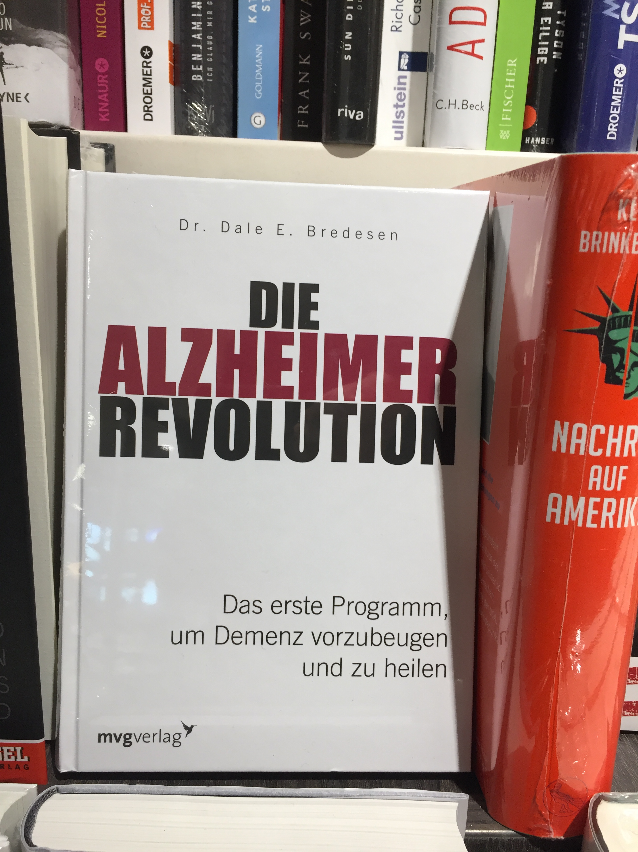
Hopeful message
“The first program to prevent and to cure dementia”
“Alzheimer’s is not an inescapable destiny anymore.”

Slide 19
Different messages?
https://www.google.ca/search?q=sperling+prevention+of+dementia&client=firefox-b&dcr=0&tbm=vid&ei=WDsxWs6sK8bFmwHQiaCQCw&start=10&sa=N&biw=987&bih=733&dpr=1
Reisa Sperling: prevention as a cocktail of medications, comparable to AIDS
http://www.euronews.com/2017/07/20/nine-steps-to-dementia-prevention

Slide 20
National contexts, cont: Larger trials US vs. EU, cont.
USA
Europe
A4 trial (Anti-Amyloid Treatment in Asymptomatic Alzheimer’s) One drug | … whether an anti-amyloid antibody can slow memory loss caused by Alzheimer’s disease.. | FINGER (Finnish Geriatric Intervention Study to Prevent Cognitive Impairment and Disability) Lifestyle/cardio-vascular | A 2-year multidomain intervention including nutritional guidance, physical activity, cognitive training, increased social activity, and intensive monitoring and management of metabolic and vascular risk factors
Autosomal Dominant Alzheimer's Disease (ADAD) Trial One drug | This study focuses on whether two investigational drugs – an active immunotherapy (CAD106) and a BACE (beta-secretase 1) inhibitor (CNP520) – can prevent or delay the onset of Alzheimer’s symptoms. | PREVENT Dementia study Lifestyle/cardio-vascular | UK study: research focuses on people in middle age to identify biological and psychological factors which may increase the risk of dementia in later life. Once identified, we would like to select those people at high risk and intervene in this process. These interventions might be lifestyle changes or measures to affect the risk of an individual developing dementia.
See Leibing, A. - Situated Prevention: Framing the ‘New Dementia’, Journal of Law, Medicine & Ethics (2018)

Slide 21
Larger trials, cont.
USA |  | EUROPE
EMERGE (also in Europe) One drug | To evaluate the efficacy and safety of Aducanumab (BIIB037) in subjects with early Alzheimer's disease (Phase 3). Also European countries, sponsored by US company (Biogen) | PreDIVA (Prevention of dementia by intensive vascular care) Cardiovascular risk factors/lifestyle | A Dutch 6-year long multicenter RCT comparing standard and intensive care of cardiovascular risk factors in preventing dementia and disability in older people: a multi-component intensive vascular care addresses hypertension, hypercholesterolemia, smoking habits, excessive weight, physical inactivity, and diabetes mellitus, which are strictly controlled with medication and lifestyle interventions.
TOMORROW Trial One drug | 3,500 asymptomatic individuals, some of whom have the Alzheimer's risk gene (APOE-e4) or the TOMM40 risk gene. The trial will explore whether the anti-diabetes drug pioglitazone can prevent mild cognitive impairment due to Alzheimer's disease. | MAPT (Multidomain Alzheimer Preventive Trial) Cardiovascular risk factors/lifestyle | A French 3-year multicenter RCT evaluating the efficacy of isolated supplementation with ω-3 fatty acid, isolated multidomain intervention, or their combination in the prevention of cognitive decline in frail individuals who are at least 70 years old. Also group training sessions (physical exercise, cognitive training, and nutritional advice) and yearly personalized preventive consultations that aim to identify dementia and frailty risk factors (vascular risk factors, nutritional problems, sensory deficits, mood disorders, and walking difficulties)

Slide 22
US vs. EU
The participants [from the US] receive solanezumab, an antibody-based drug that aims to reduce brain amyloid-beta, which recently failed to improve mild Alzheimer’s dementia. Despite the failure, researchers speculate the drug may be effective in preventing dementia in people who have amyloid-beta aggregates in the brain (Kegel 2017).
Recent research suggests changes in the brain may precede symptoms of Alzheimer’s disease by many years. (…) Our research (…) focuses on people in middle age to identify biological and psychological factors which may increase the risk of dementia in later life. Once we have identified which factors are changing we would like to select those people at high risk and intervene in this process. These interventions might be lifestyle changes or measures to affect the risk of an individual developing dementia. (PREVENT n.d., UK)

Slide 23
Pharma-dominated major int’l prevention initiatives
The UK-based Dementia Discovery Fund : “Our goal is to invest over $200m over fifteen years to support the creation of novel disease-modifying drugs for dementia… “The Department of Health, the charity Alzheimer’s Research UK and … six pharmaceutical firms have raised $100m (£65m) to invest in early-stage, novel treatments for (…) dementia (…) [T]he company is joined by the US drugmakers Johnson & Johnson, Biogen, Eli Lilly and Pfizer, and Japan’s Takeda.”
The (US based) Global Alzheimer Platform : “the GAP Foundation is joining together leading academic researchers, pharmaceutical companies, nonprofit organizations and foundations, and governments around the world to reduce the time, cost and risk of Alzheimer’s clinical trials, in order to speed innovative medicines …”

Slide 24
Aducanumab – reactions to the failure of the Phase 3 EMERGE and ENGAGE studies (PRIME in Europe)
(A) those who believe that the antibody tested was not the right one, but that a similar antibody will be a solution, and that the current Aß model (or tau) is not yet dead;
(B) those who think that still earlier stages of AD need to be considered and that the current target of either ß amyloid or tau or both is still valid;
(C) prevention is seen at the moment as the only possible pathway
(for B): ‘Even though this trial was in the early symptomatic phase of AD, it is still in the phase when Aβ is no longer likely to be the driving process but where tau and inflammation probably are. … I think Aβ is still a good target for the primary and maybe secondary prevention trials of AD, before tau and inflammation have started driving the disease,’ he added.
(David Holtzman, Washington University, in: Alzforum 2019)

Slide 25
Cont.
Stefano Sensi, an Italian researcher (CeSI-MeT), for example, writes that
(C): The failure of the Phase 3 aducanumab trial is another warning that the field must take a different approach. Some authors have already called for a rejection of the amyloid hypothesis (…) AD is a multifactorial condition in which, along with Aβ accumulation, the convergence of many genetic, environmental, vascular, metabolic, and inflammatory factors promotes the neurodegenerative process. (…) we need to remind ourselves that a third of AD cases are strongly dependent on the concerted activity of modifiable factors like low education, midlife hypertension, midlife obesity, diabetes, physical inactivity, smoking, and depression. (…) It is time to take up the challenge of complexity. (Alzforum 2019: no page)
Kasper Kepp from the Technical University of Denmark writes :
(C): It has been known for many years that the amyloid hypothesis cannot be correct; the reason it survives is because it is appealingly simple and offers a one-sided treatment strategy that pharma can pursue easily by antibodies and inhibitors. (…) Unfortunately, these people include, because of the paradigm's previous popularity, major opinion-leaders and big pharma with a responsibility for listening to only some key opinion makers of the dominating paradigm in the time of its sunset. (Alzforum 2019: no page)

Slide 26
Conclusion 2:
Different countries might receive different kinds of recommendations.
« MCI is given less importance in Europe when compared to the US. » (Peter Whitehouse, personal communication)
And Canada?
The influence of such translation processes (pharmaceutical industry lobbying, media restrictions etc.) need to be studied in more detail.

Slide 27
2.d Case study: situating a specific national context: Brazil
Otherness (future: Germany, Canada, Switzerland)

Slide 28
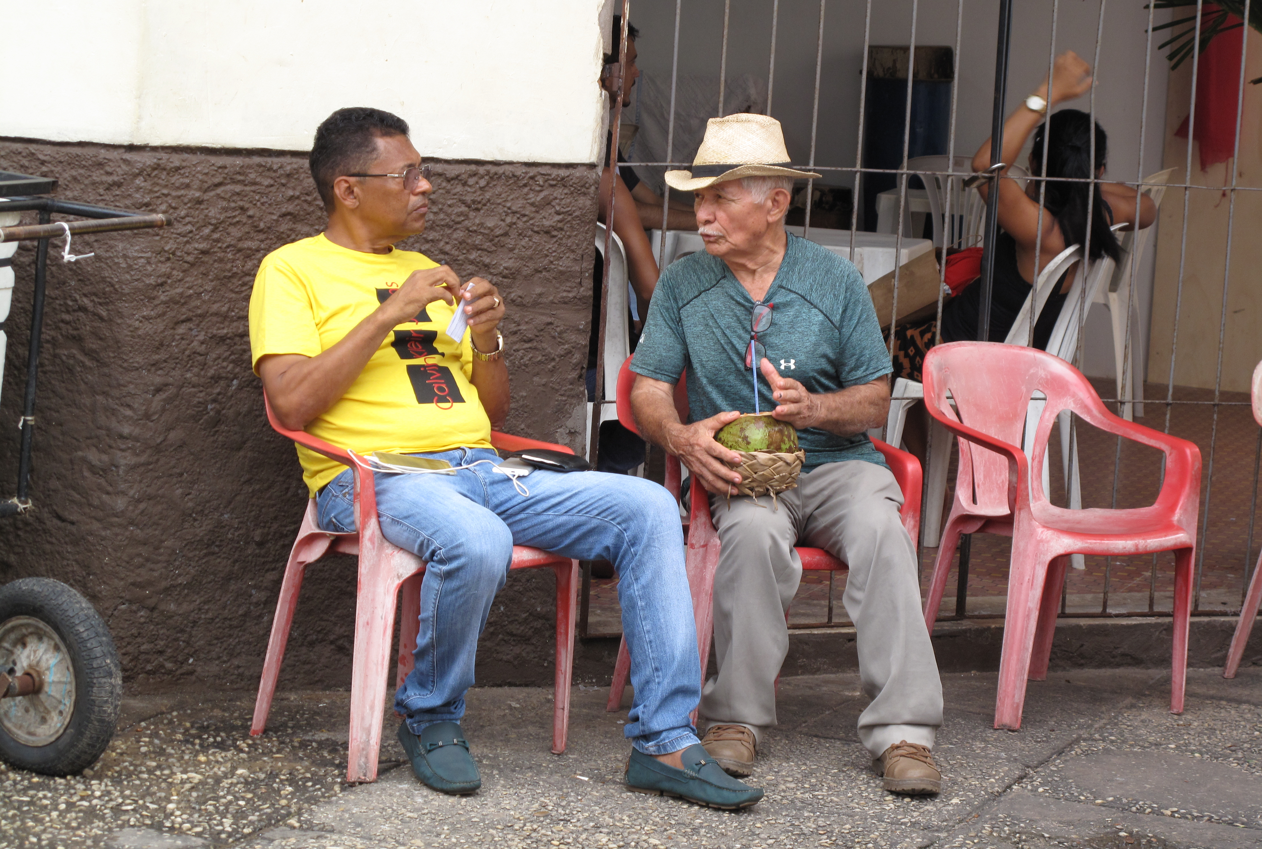
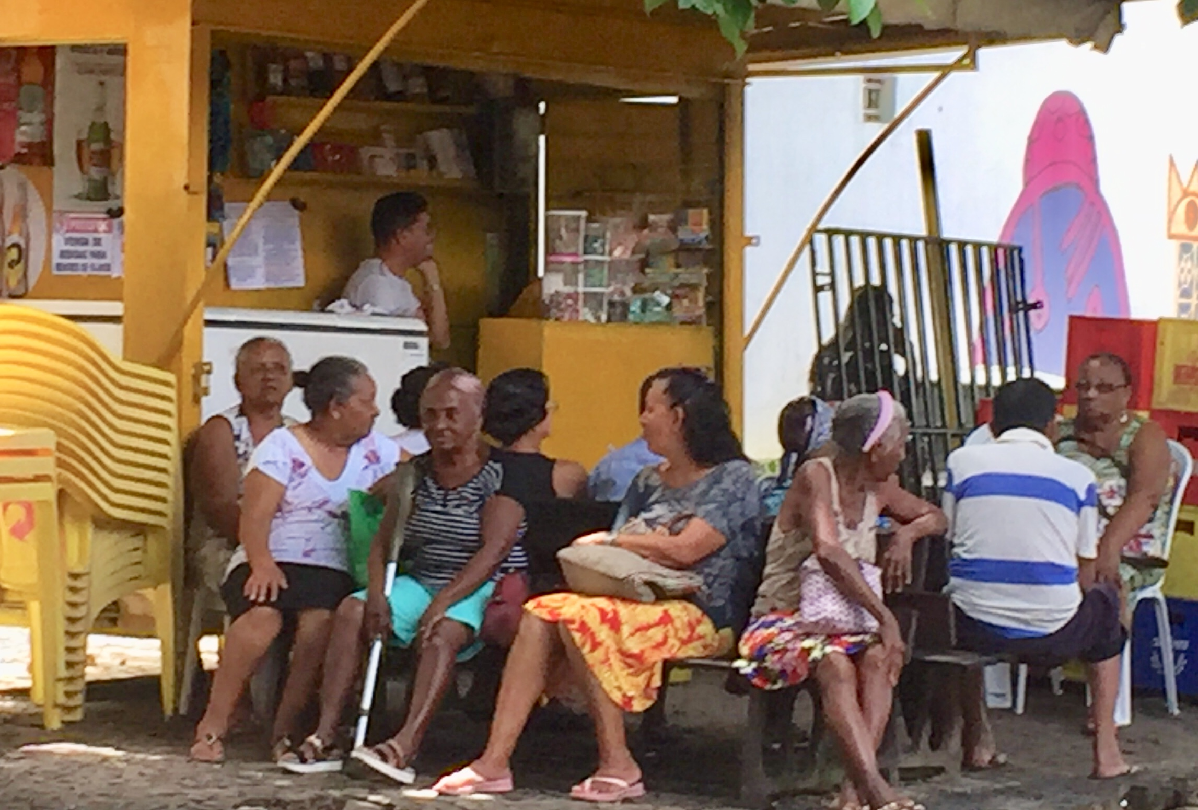
3. Dementia prevention in Brazil
Embedding risk factors in local contexts

Slide 29
Brazil – aging, dementia, risk factors
7,3% seniors in 1991 ; 15% in 2025
Life expectancy: 75.67, important class-related differences (WHO 2018)
Older people and
Hypertension: The prevalence of arterial hypertension was 74.9% (Lima Sousa et al. 2019)
Diabetes: 10 % in 1998, 13 % in 2003 and 16 % in 2008 // 17.9% (2011) (Mendes et al. 2011)
30% of Brazilians smoke 20+ cigarettes/day, national tobacco restriction programs reached less young women and older people (Monteiro et al. 2010)
40% prevalence of physical inactivity among adults, highly class dependent (Hallal et al. 2012)
Depression (66-84 yrs): Prevalence rates of 7.0% for major depression, 26.0% for CSDS, and 3.3% for dysthymia (Barcelos-Ferreira et al. 2010)
Probable increase in the prevalence of dementia in the 65+ age-group, from 7.6% to 7.9% between 2010 and 2020: 55,000 new cases per year (Burlá et al. 2013)

Slide 30
“Free medications, here at the Popular Pharmacy” “Diabetes and hypertension, It is through this program that you get the meds with until 90% of discount. In the case of hypertension and diabetes, these meds are for free.”
“Não deveríamos ter tantos casos [de demência] por aqui; aqui os remédios para diabetes e hipertensão estão de graça. Mas a vida dessas pessoas é muito difícil…” (Cristina Hoffmann, MS, 2016)

Slide 31
Geriatricians about dementia prevention in Brazil
… there is the cultural question, that people think they only have to go to the doctor when they are very ill. And do not do anything before getting sick… And then, when they need help, the access to health care is very difficult, (Female geriatric resident)
They don’t take these medications – hypertension is so common, why take this medication? Because it makes people ordinary. … Hypertension is a disease of poor people. ‘I want to have a disease of rich people’, they say. (Male geriatrician)
Vascular dementia in Brazil, ave Maria! I am sure it is worse than in any other country. In the first world, diabetes and hypertension are well controlled. We will never get there. That is very sad. And especially in the public system [SUS], that’s a mess. (…) It is difficult to have access to medications, difficult to change lifestyle, difficult to change the diet and all that. (…) The access to health care is difficult – because of all this patients have more ischemic events, microangiopathies (…) And so rates of mixed dementia and the vascular one are very high. In Ceilândia [very poor area], people are unable to buy certain medications. And if I decide to prescribe one they get for free, it will likely be an old medication, with heavy side effects. It is heart-breaking. Sometimes families can buy one medication, but not another. (female geriatrician)

Slide 32
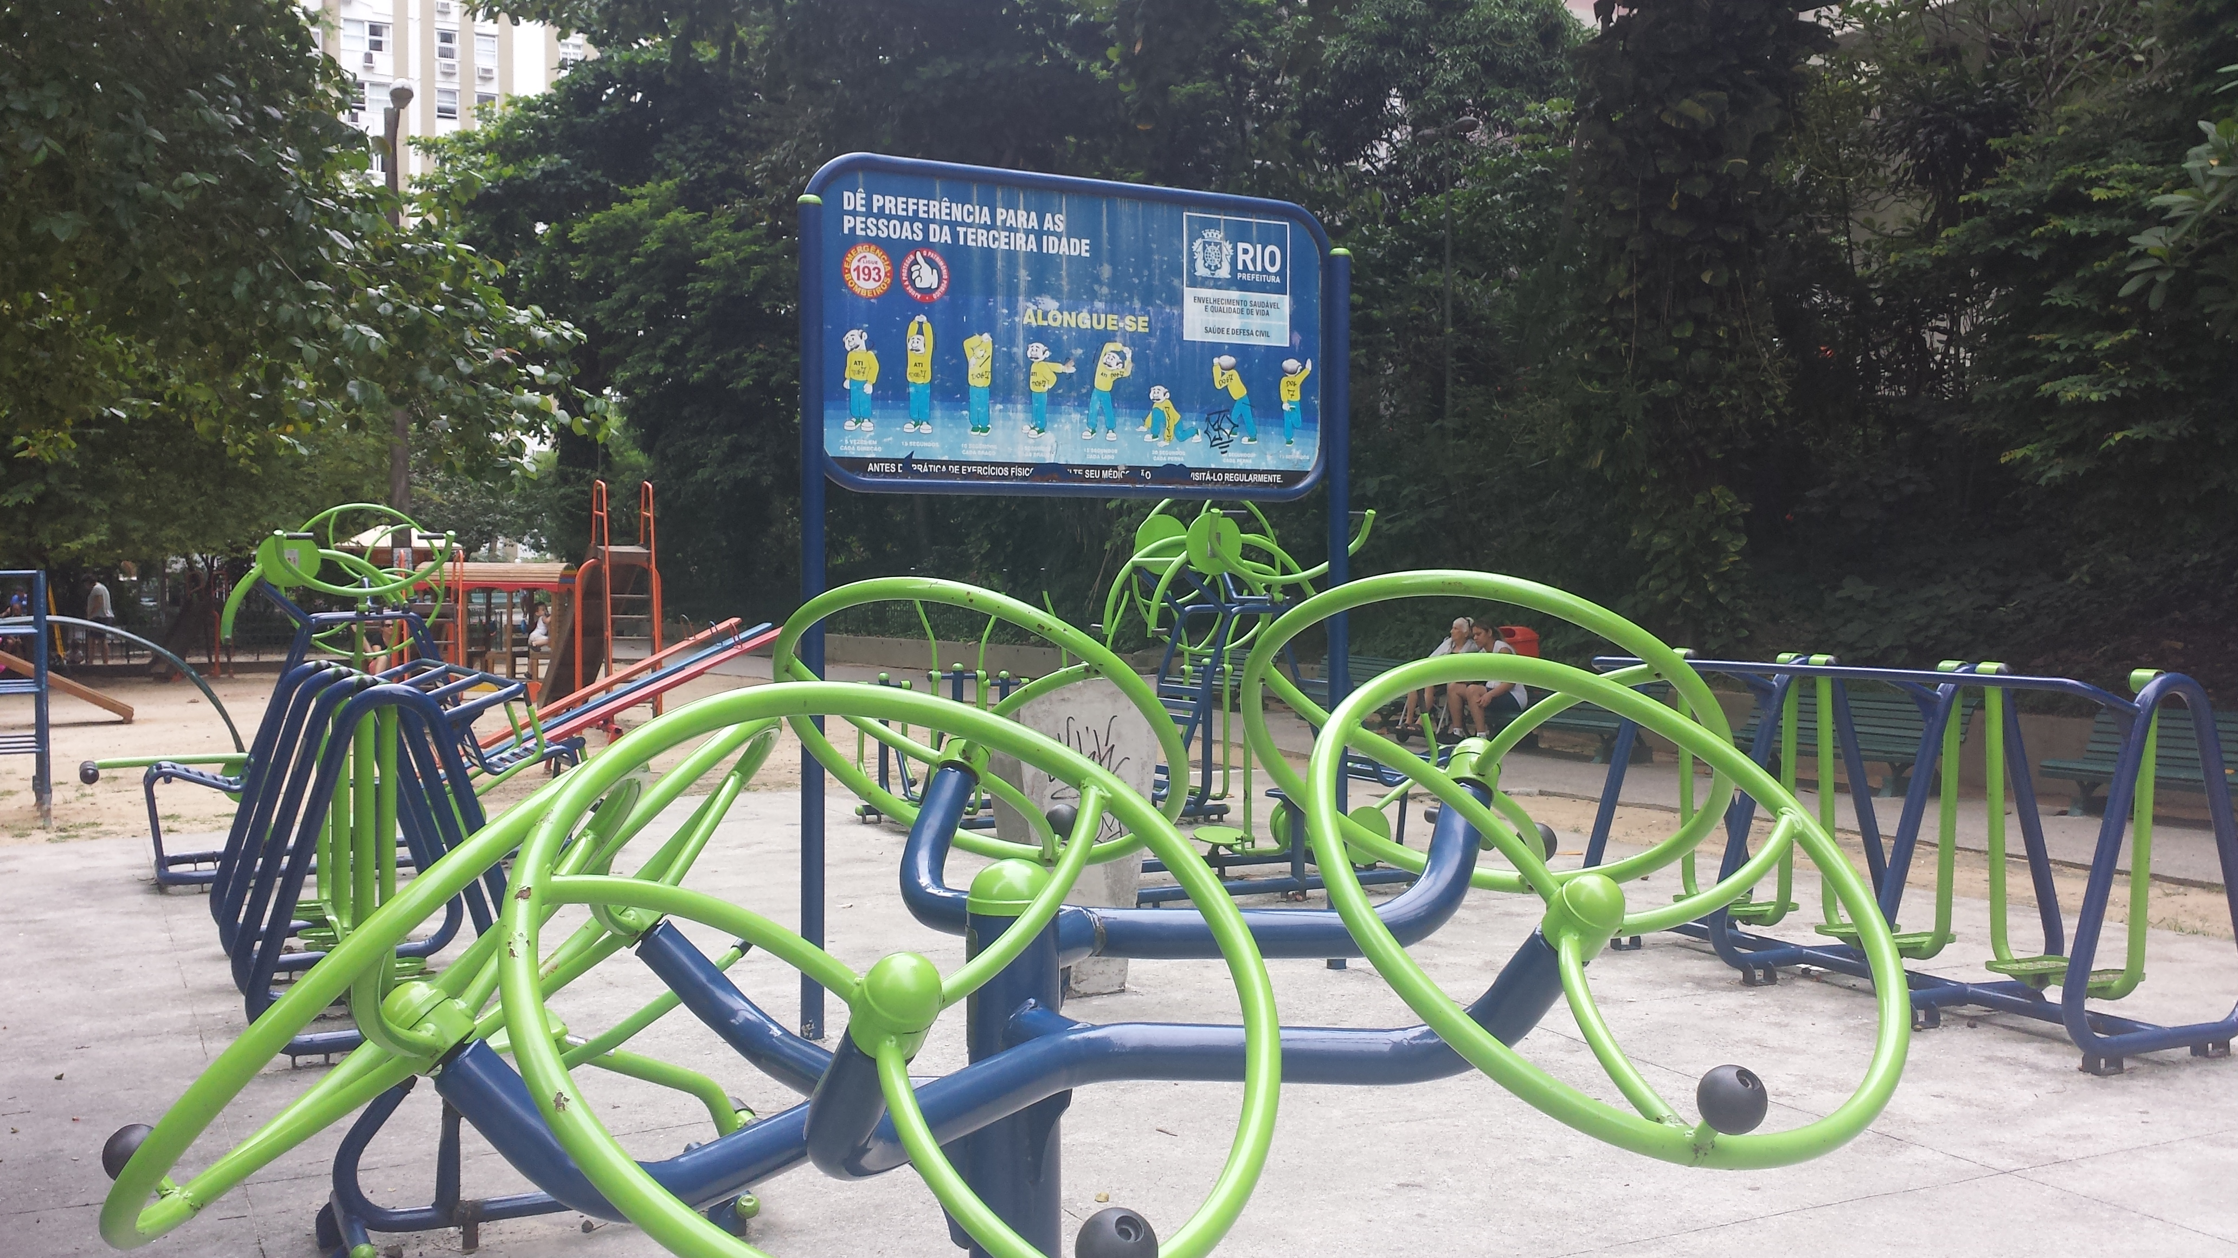
Care of self

Slide 33
3. Conclusion: Situating the prevention of dementia, examples on different levels
In some (richer) regions of the world dementia incidence rates are declining, for instance in the US (Manton, Gu and Ukraintseva 2005), Holland (Schrijvers et al. 2012), Sweden (Qiu et al. 2013), and England (Matthews et al. 2013). (looking at health care system)
The turn toward integrating pre-clinical phases into the definition of the dementia syndrome itself will happen more likely on the North American continent. (science discourse)
Media images: once passive victims of the disease, have since come to be seen as active agents of self-care in some contexts. (public images/lived experience)
Critiques regarding prevention campaigns in general. “a focus on the individual is ethically questionable, ineffective and ignores relevant research that suggests systemic factors, not individual choices, are behind the epidemic ...” (Mayes, 2016) (problematizing public health recommendations)

Slide 34
Cont., Conclusion
The preventive turn in dementia research is a real chance for a better old age, when
a) the complexity and interplay of genetic, physiological, lifestyle, environmental, and political-economic factors are taken into consideration and
b) when, first of all, structural factors – access to good health care, food, and education, as well as a clean environment – are guaranteed for all.
Translations of findings need to be carefully monitored, for example by looking at interest groups and (situated) differences among groups and nations at both macro and micro levels of “doing prevention”.

Slide 35
News?
Neurologist Sir James Crichton-Browne (1905):
“Americans break down at an earlier age than Europeans, especially from nervous ailments, and he (Hamilton) attributes this to their struggles for the rapid accumulation of wealth, to the competition and ambition which are largely stimulated by agitational newspapers… to hustling, over-eating, insufficient exercise and luxurious living general.”
Crichton-Browne, Sir J. – The prevention of senility. The Journal of Preventive Medicine, Aug 1905, pp. 1-26.

Slide 36
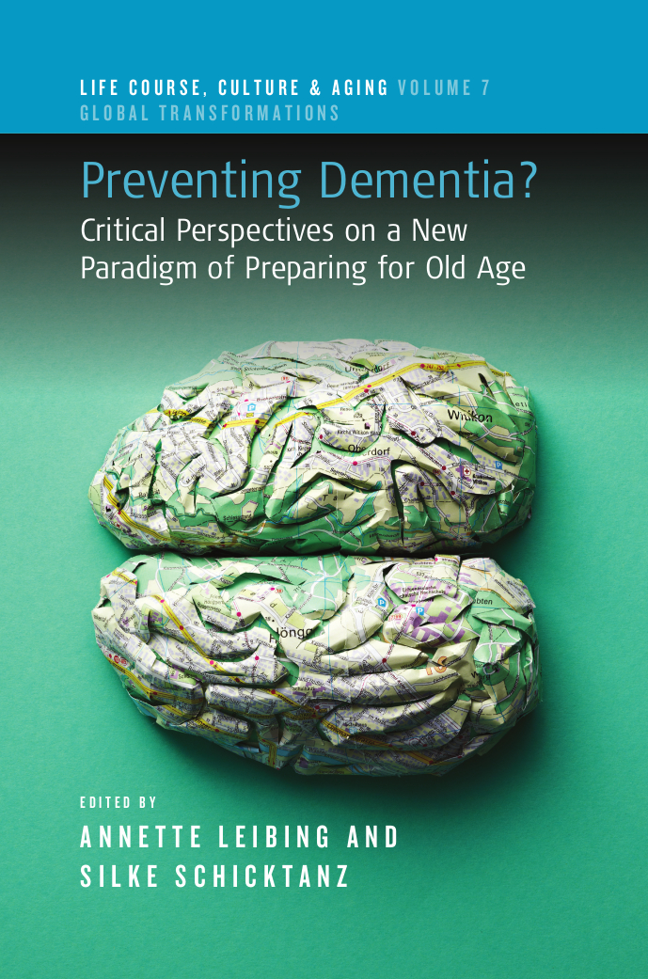
Thank you et merci!
For further questions: annette.leibing@umontreal.ca
This research is funded by
a SSHRC Insight grant; by an
ERA-NET NEURON - ELSA grant (Canadian part: FRQS and CIHR);
and a DFG (Deutsche Forschungsgemeinschaft) grant
Berghahn Pubishers

