Slide 1
Can moderate dietary carbohydrate restriction help sustain healthy cognitive aging?
Stephen Cunnane
Université de Sherbrooke
Website: recherche-cerveau-sherbrooke

Slide 2
Disclosures
Government funding
Private donations
Corporations
(Nestlé Health Science, Abbott, Cerecin, Cargill)

Slide 3


Slide 4
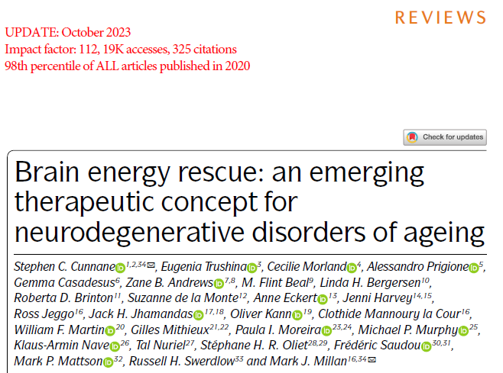
NATURE REVIEWS DRUG DISCOVERY
September 2020

Slide 5
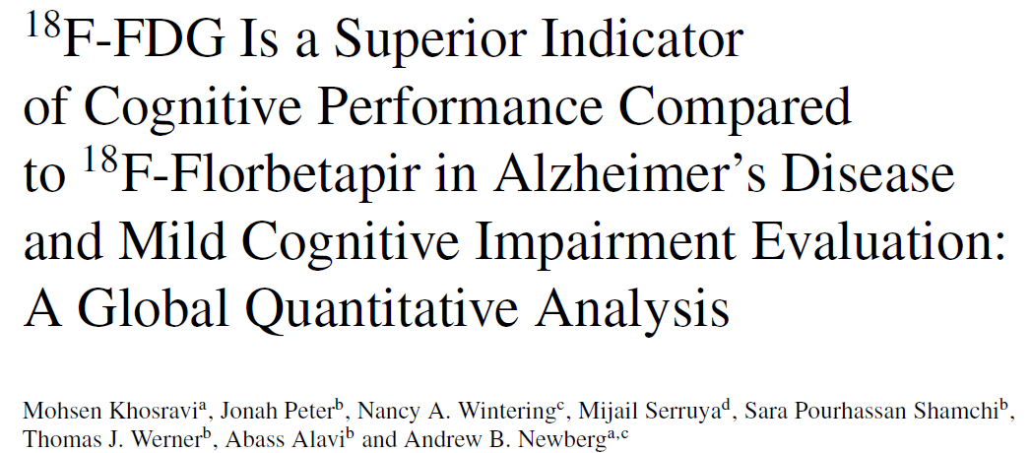
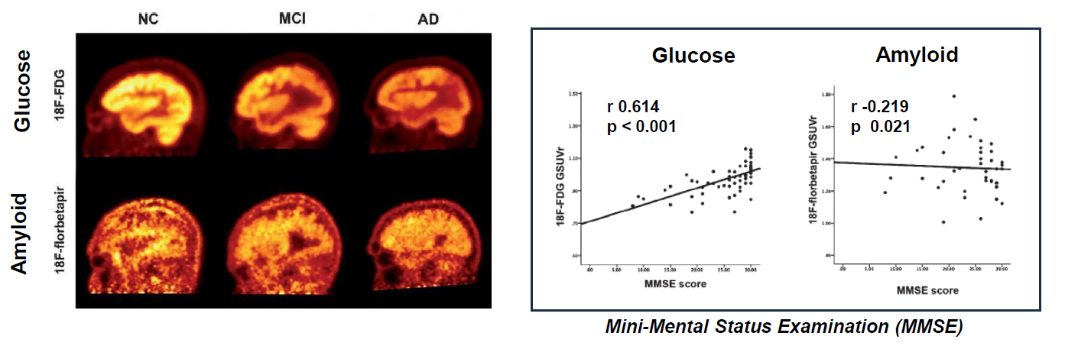
(J Alz Disease, 2019)
Control
Alzheimer
10/30
30/30
10/30
30/30
MMSE – mini-mental state exam ( …/30)

Slide 6
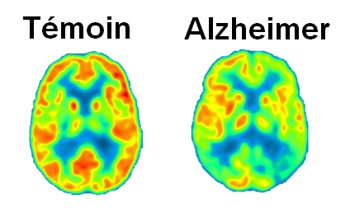
Brain energy (glucose) deficit in Alzheimer disease:
An early, significant and well-known problem
r
Control Alzheimer
Normal energy requirement: 100-125 grams of glucose/day
Mild cognitive impairment: glucose uptake ↓ ~10%
Alzheimer: glucose uptake ↓ ≥20-40%
(parietal cortex, temporal cortex, posterior cingulate)
(Cunnane et al. Nature Reviews Drug Discovery, 2020)

Slide 7



Fuel is not getting into the brain
A vicious cycle
Energy = Memory

Slide 8


Slide 9
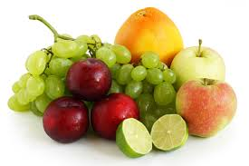
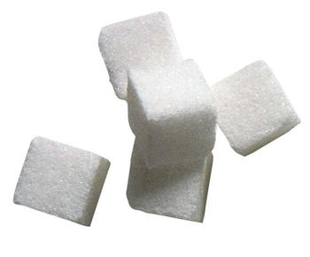
Why is fuel not getting into the brain?
One of the main problems – SUGAR
↑Dietary sugar = ↓ brain sugar (glucose)
A vicious cycle
Too much =
Not enough !
Energy = Memory

Slide 10
Strategies to fuel and protect the brain
One of the main problems – SUGAR
↑Dietary sugar = ↓ brain sugar (glucose)
A vicious cycle
Too much =
Not enough !
Energy = Memory
EMERGING SOLUTIONS

Slide 11

Strategies to fuel and protect the brain
One of the main problems – SUGAR
↑Dietary sugar = ↓ brain sugar (glucose)
A vicious cycle
Too much =
Not enough !
Energy = Memory
EMERGING SOLUTIONS
① KETONES
Alternate fuel

Slide 12
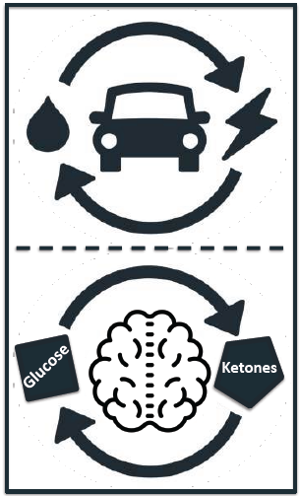
The brain – a hybrid car
Glucose
(a form of sugar)
(90 - 95%)
Ketones
(derived from fats)
(5 - 10%)

Slide 13
Ketone body (ketone) synthesis
Dietary or stored fatty acids
Ketone salts, esters
Ketogenic medium chain triglyceride
(kMCT: C8, C10)
O
OH
=
–
CH₃ – C – CH₂ – COOH
CH₃ – CH – CH₂ – COOH
Acetoacetate
D−β-Hydroxybutyrate
O
=
CH₃ – C – CH₃
Acetone
(on the breath)

Slide 14
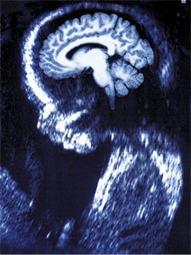
Ketones and the brain:
Learning from the infant
Ketones from medium chain triglycerides
(acronym MCT) in mother’s milk

Slide 15
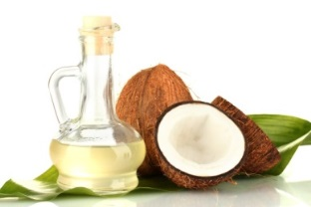
Strategies to fuel and protect the brain
One of the main problems – SUGAR
↑Dietary sugar = ↓ brain sugar (glucose)
A vicious cycle
Too much =
Not enough !
Energy = Memory
EMERGING SOLUTIONS
① KETONES
Alternate fuel
MCT- medium chain triglyceride oil

Slide 16
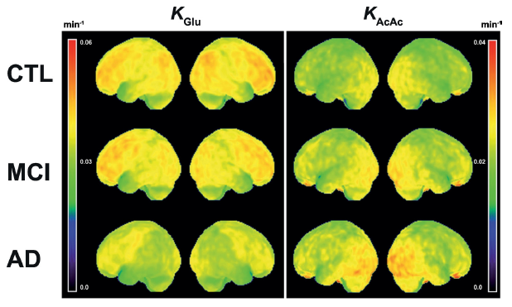
Impaired brain energy metabolism in MCI and AD is specific to glucose; no brain deficit in the capacity to take up ketones
Glucose
Ketones
Glucose
Decrease
Increase
(n ~20/group)
(Castellano et al. 2015, Croteau et al. 2018, Fortier et al. 2019)
(Lying-Tunell et al. 1981, Ogawa et al. 1996, Neth et al. 2020, Saito et al. 2021, Calon et al. 2022)

Slide 17
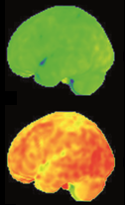
Strategies to fuel and protect the brain
One of the main problems – SUGAR
↑Dietary sugar = ↓ brain sugar (glucose)
A vicious cycle
Too much =
Not enough !
Energy = Memory
EMERGING SOLUTIONS
Before (low)
① KETONES
Alternate fuel
MCT- medium chain triglyceride oil
After
(better)
↑ brain energy.
↑ cognitive performance in relation to brain ketone uptake.

Slide 18
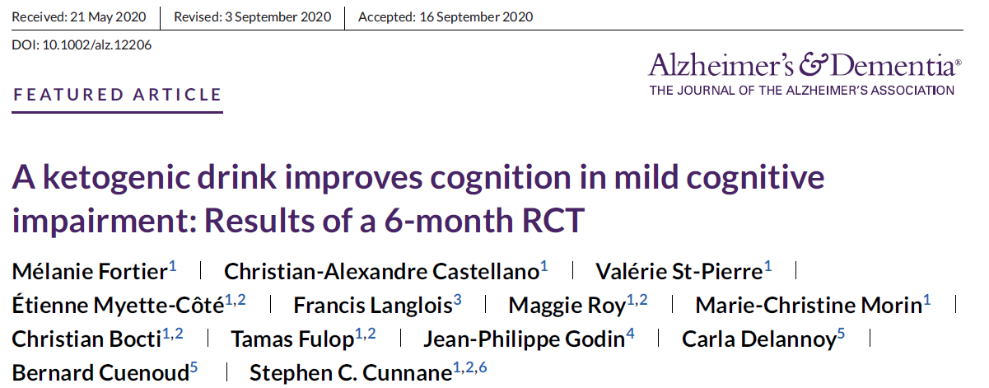
Published in 2021

Slide 19
Strategies to fuel and protect the brain
One of the main problems – SUGAR
↑Dietary sugar = ↓ brain sugar (glucose)
A vicious cycle
Too much =
Not enough !
Energy = Memory
EMERGING SOLUTIONS
Before (low)
① KETONES
Alternate fuel
MCT- medium chain triglyceride oil
After
(better)
↑ brain energy.
↑ cognitive performance in relation to brain ketone uptake.
② EXERCISE + KETONES
(in progress)

Slide 20
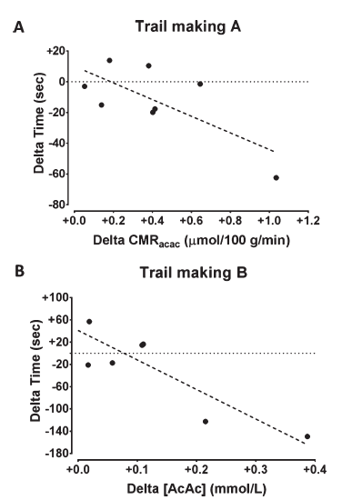
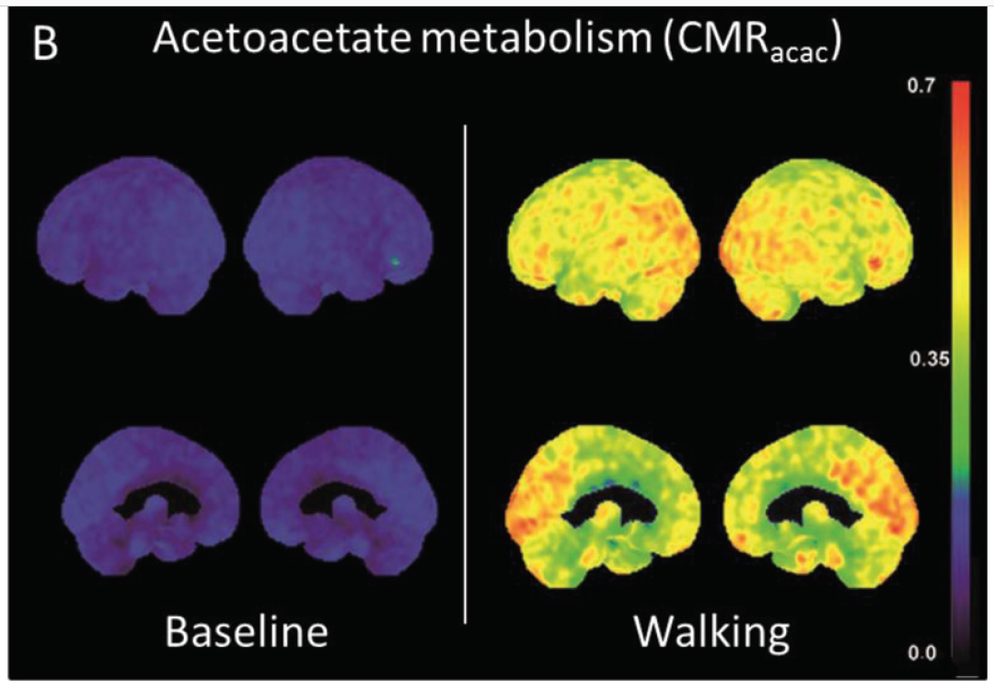
Mild-moderate exercise triples brain ketone uptake in Alzheimer’s disease
N=10, 4 km/h, 3 times/wk, 12 wk
(Castellano et al. J Alz Disease, 2017)

Slide 21
Strategies to fuel and protect the brain
One of the main problems – SUGAR
X
↑Dietary sugar = ↓ brain sugar (glucose)
A vicious cycle
Too much =
Not enough !
Energy = Memory
EMERGING SOLUTIONS
Before (low)
① KETONES
Alternate fuel
MCT- medium chain triglyceride oil
After
(better)
↑ brain energy.
↑ cognitive performance in relation to brain ketone uptake.
③ decrease dietary SUGAR, ADD KETONES (in progress)
② EXERCISE + KETONES
(in progress)

Slide 22
The brain – a hybrid car:
As we get older, the goal is to increase the
contribution of ketones as a brain fuel
because their brain uptake is not impaired
Glucose
(Aim for 2/3)
Ketones
(Aim for 1/3)

Slide 23
The brain – a hybrid car:
For this to work well in older people, we
need ways to make INSULIN more effective
Glucose
(Aim for 2/3)
Ketones
(Aim for 1/3)

Slide 24





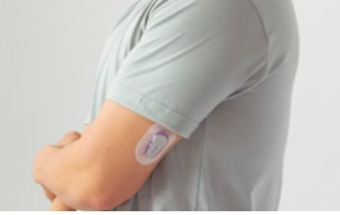
The SAGE project: reduced carb intake in a retirement home
ELIGIBILITY
NUTRITION
REDUCED CARB MENU (2 MONTHS)
Continuous glucose monitoring
Continuous glucose monitoring
(Vandenberghe et al., in press, Appl Physiol Nutr Metab 2024)

Slide 25

The SAGE project: reduced carb intake in a retirement home
 | 18 women / 6 men
Age (years) | 83 ± 6
Body mass index (kg/m2) | 28 ± 5
 | Regular Menu | Reduced Carb Menu
Weight (kg) | 72 ± 18 | 71 ± 17
Hemoglobin A1C (%) | 5,9 ± 0,6 | 5,5 ± 0,5*
Ketones (µM) | 63 ± 34 | 131 ± 153*
Triglycerides (mM) | 1,7 ± 0,6 | 1,3 ± 0,4*
Cholesterol (mM) | 4,7 ± 1,1 | 4,4 ± 1,2*
* P < 0,05
(Vandenberghe et al., in press, Appl Physiol Nutr Metab 2024)

Slide 26
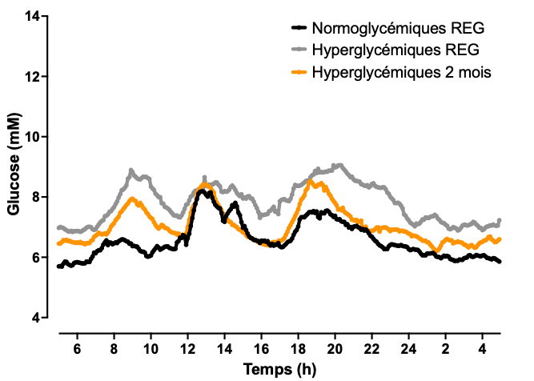
Reducing carbohydrate intake reduces blood sugar (glucose): A 2-month study in a retirement home
Normal blood sugar
High blood sugar (before)
High blood sugar (after: 11% ↓)
BAD
GOOD
Breakfast
Lunch
Supper
Time (24-hour clock)
(Vandenberghe et al., in press, Appl Physiol Nutr Metab 2024)

Slide 27
Reducing carbohydrate intake reduces blood sugar (glucose): A 2-month study in a retirement home
Normal blood sugar
High blood sugar (before)
High blood sugar (after: 11% ↓)
BAD
GOOD
Breakfast
Lunch
Supper
Time (24-hour clock)
Insulin working better
Also increased ketones
Well accepted
No issue of safety
(Vandenberghe et al., in press, Appl Physiol Nutr Metab 2024)

Slide 28
The SAGE project: reduced carb intake in a retirement home
Normal blood glucose, regular meals
Normal blood glucose, reduced carb meals
High blood glucose, regular meals
High blood glucose, reduced carb meals
% of time blood glucose is too high
(Vandenberghe et al., in press, Appl Physiol Nutr Metab 2024)

Slide 30
Better brain fuel = better memory
Reduce dietary sugar (reduces insulin)
Table sugar (sucrose) is not brain sugar (glucose)
Add an MCT or a ketone supplement
Do some exercise - moderate but regular
Long-term studies in retirement homes now warranted

Slide 31
Thank you, MERCI !
Team and collaborators
Valérie St-Pierre, Mélanie Fortier, Marie-Christine Morin, Karine Groulx, Camille Vandenberghe, Etienne Croteau,
Gabriel Richard, Elisabelle Hardy, Dr. Christian Bocti,
Dr. Tamas Fulop
Participants
Funding partners
Alzheimer Society of Canada, Alzheimer Association USA
Neurosciences Sherbrooke, Nestlé Health Science
Clinical Research Chair in Ketotherapeutics
Université de Sherbrooke
https://recherche-cerveau-sherbrooke.ca/

Slide 32


